Slide 1

European Parliament elections 2019: action plan

Slide 2
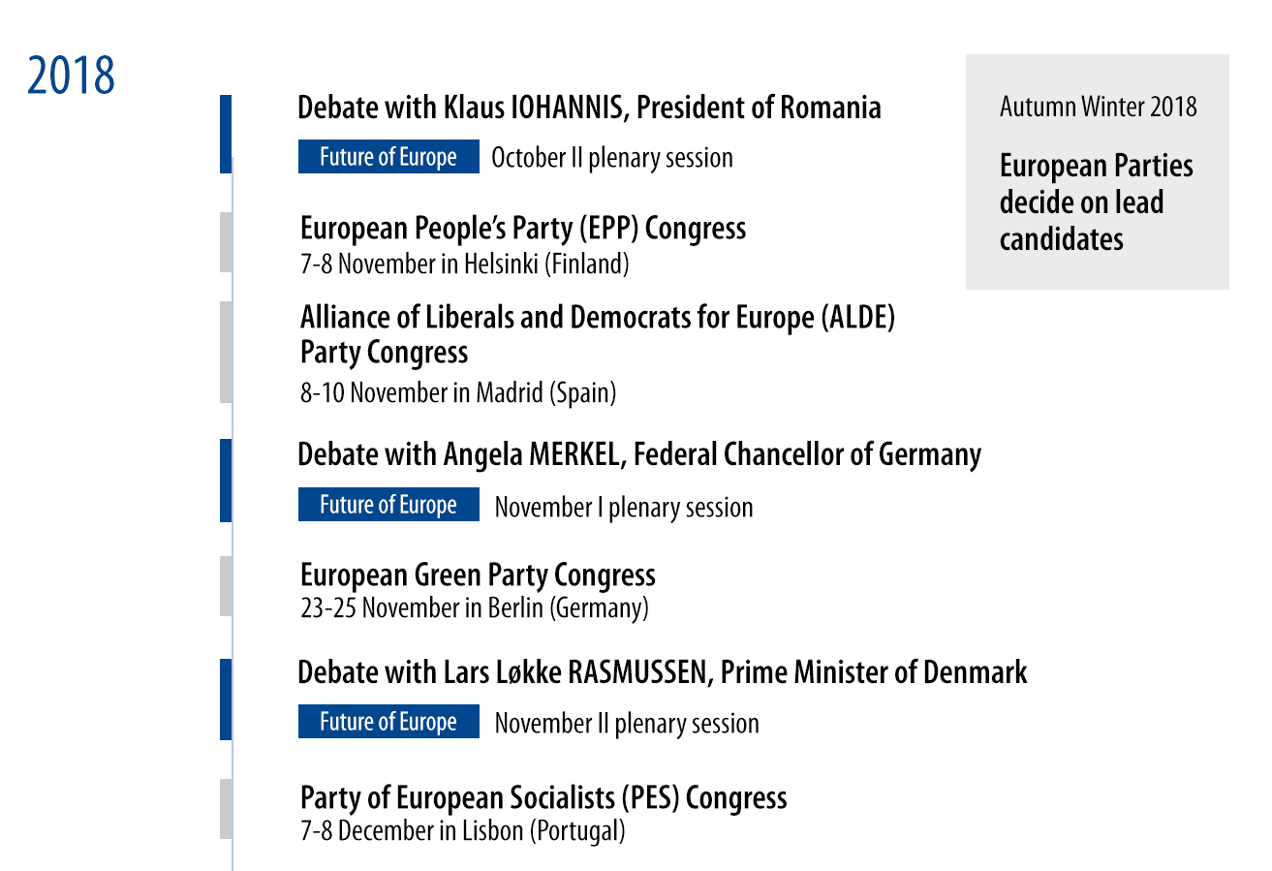
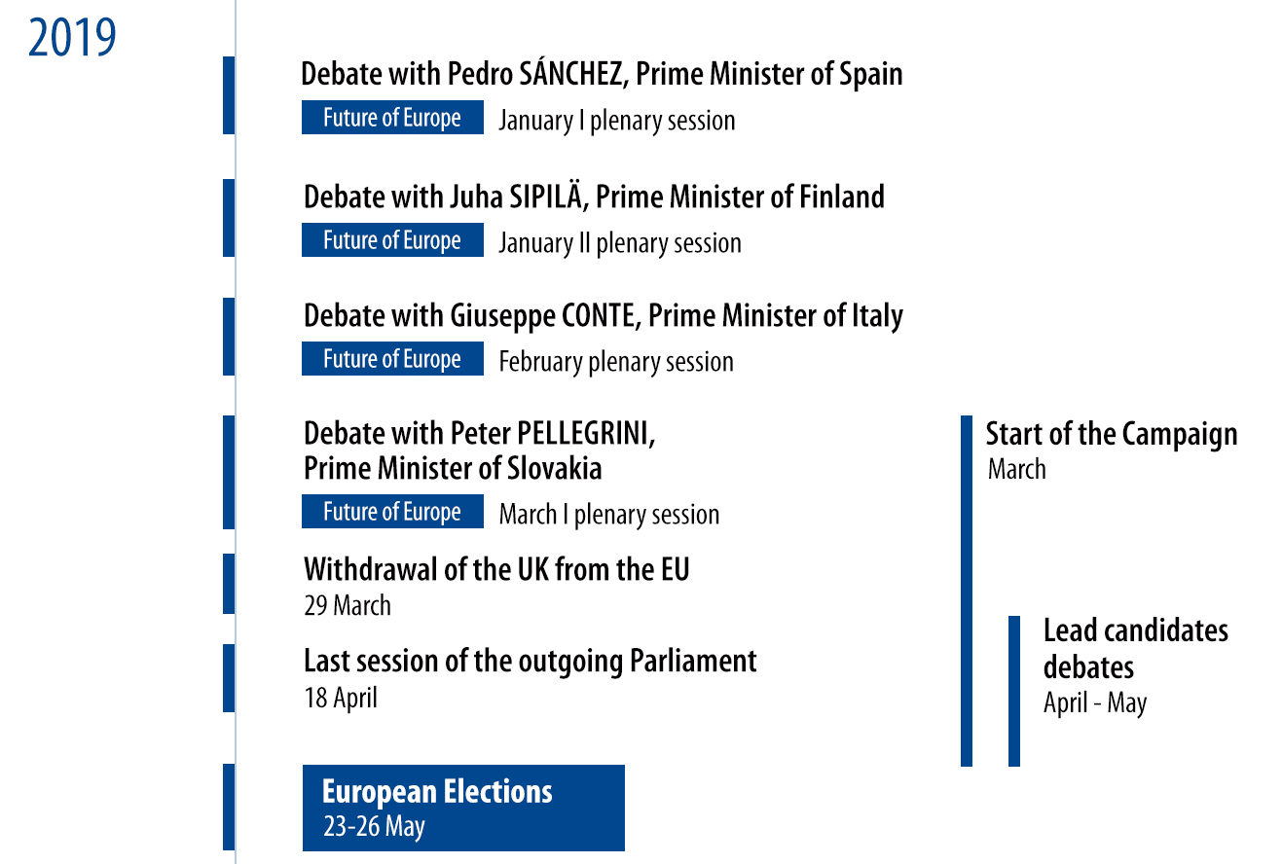

Timeline
VOTING: 23-26 May 2019

Slide 3
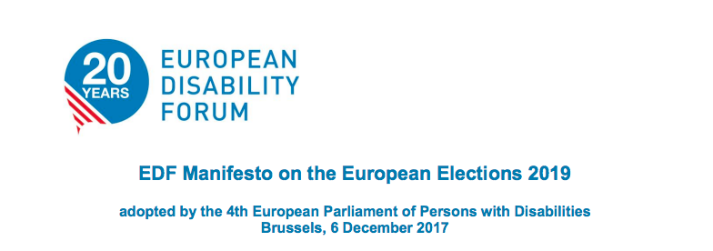

Manifestos
#europeforpatients
Fully accessible and inclusive European Elections
A comprehensive European Disability Strategy 2020-2030
EU funding to secure equal opportunities and non-discrimination
An EU Pillar of Social Rights which improves the living conditions of persons with disabilities and their families
An accessible Europe: European Accessibility Act, accessible formats for print disabled persons, passengers’ rights…
A Europe of Human Rights: gender equality, women and girls with disabilities...
Accessing the healthcare we need with no discrimination
Being empowered
Driving the development of digital health
Being a partner in driving better research
Helping make better health policy

Slide 4
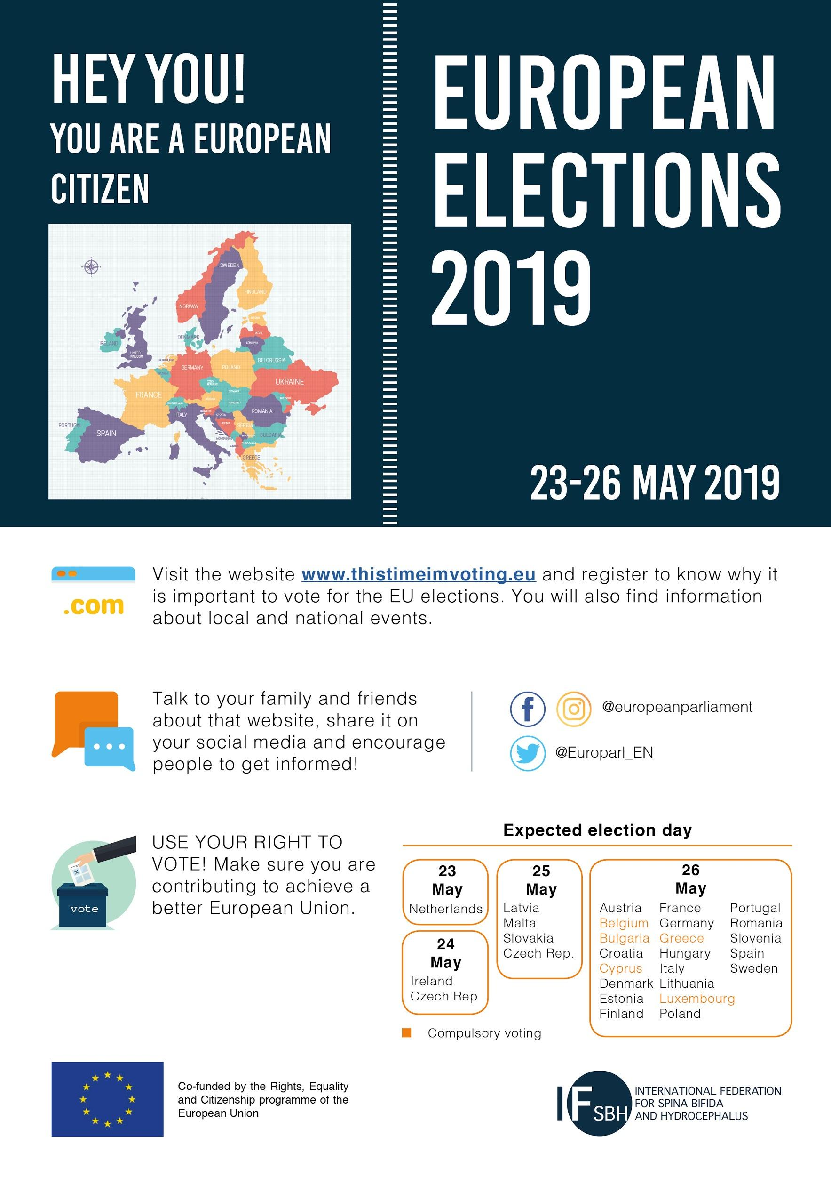
Action for IF members:
Print and share infographic
2. Article
STEPS:
Read manifestos
Choose your priority
Write an article in your own language (translation in EN would be appreciated for a wider impact)
Contact other organisations, make a coalition
KEY: Contact any politician in your country (local, regional, national level) and share the article with him/her and the party
Share with your members: article, poster and encourage them TO VOTE!
February/March 2019: contact parties at national level
23-26 May: go voting!
Visit thistimeimvoting.eu

Slide 5
Key links/dates
LINKS:
EPF webinar ‘EU Affairs, EU Institutions and EU legislative process’
Press service contact list
Thistimeimvoting.eu
European Parliament website
DATES:
European Day of Persons with Disabilities conference: 3-4 December 2018
Rare Disease Day: 28 February 2019
UN Zero Discrimination Day: 1 March 2019
World Birth Defects Day: 3 March 2019
UN International Women’s Day: 8 March 2019
World Health Day: 7 April 2019
National/Regional days

Slide 6
Get informed, go voting
THANK YOU!
Contact me: carmen.clemente@ifglobal.org

